Slide 1

Team Project

Slide 2
Contents
Introduction of the team members and roles
Aims and Objective
Core features
Gantt Chart
Web page designs
ER Diagram

Slide 3
Aims and Objectives
Aims
Providing quality content on the website
To achieve a successful websites and to increase the chances that a customer will purchase.
Objectives
Increase more sales
Website to work on all devices including mobile devices
For the website to be visually aesthetic

Slide 4
Team Members
Web Project Manager (PM) : Antoniya Ivanova (21356903)
Information Architect: Tony Mottershead (21311791)
Web Designer: Nuryaszmin Azahri (21390420)
Back-end Developer: Harrison Towler (21325616)
Front-end Developer: Saeed Sharif (21315262)
Quality Assurance Tester: James Kamalu 21325044

Slide 5
Web Project Manager: Antoniya Ivanova
Tasks and Responsibilities:
Organized all activities for the team members
Communicate with all team members
Keep on tracks with the schedule
Discuss about the team project.
Project Plan

Slide 6
Information Architect: Tony Mottershead
Task and responsibilities:
Collect and gather information
Help the team members
Research and planning
Organised the content
Report all the research
Gantt Char, ER Diagram etc

Slide 7
Web Designer: Nuryaszmin Azahri
Task and responsibilities:
Develop the functionality of the website
Establishing design guidelines, standards and best practices
Communicating design ideas
To maintain and update the website that have create
Use Adobe Photoshop for image editing, banner etc
Responsible in control of the entire website and ensure the website is easy to use and the information is easy to access.

Slide 8
Back-end developer: Harrison Towler
Task and responsibilities:
Responsible for technical configuration and maintenance of the web server.
Make the server, application and database communicate with each other like PHP languages, Netbeans to build the application and tools for MySQL.
Collect and gather the data information like customer information, the stock list etc.
As a back-end developer is to make sure that the data is storing in the system and performs the testing and debugging the system.

Slide 9
Challenges we may face:
Some challenges we may face will include:
How User data will be stored within the system so that it can be retrieved by the customer if needed? Solution: We will use a web server such as MySql to store user details which can be amended via an admin account created which only the company has access to.
How inventory will be stored within the website and how would we access it?
Solution: This would be a similar Solution to the previous question but this would be stored within another database, we would use this to store pictures of the inventory as well as product sell by dates, ordered and delivery dates within the system services.
The Front-end Developer will need to have this fully functional to proceed with their Coding for things to run smoothly

Slide 10
Front-end Developer: Saeed Sharif
Tasks and responsibilities:
Convert design elements into pages
Code design elements in PHP, CSS & Script
Develop the web pages using Notepad++
Integrate PHP and Script
Create an interactive feature to each website
Allow the users to experience the website that is easy to read and relevant. ( User friendly)

Slide 11
Quality Assurance tester: James Kamalu
Task and responsibilities:
Responsible for ensuring that the website functions are intended
Test will be performed once the website is complete
Coordinate one or more rounds of testing
Troubleshooting
Check the codes
As Quality Assurance tester will work with the front-end and back-end developer.

Slide 12
Difficulties we may come across:
Debugging the system
A major error within the database
If you where to lose debugging reports this could cause a fatal error as loss of past data would make the process a lot harder to solve Solutions: making sure the Team is running affectively and that all procedures and measure are in place for fluid work flow.
Also to assure that all is stored correctly from the debugging reports

Slide 13

Core Features
Navigation Bar
Payment systems
Log in/Register System
Currency converter/language translation
Admin
Images and descriptions of products
Customised Shopping cart
Stock status of products

Slide 14
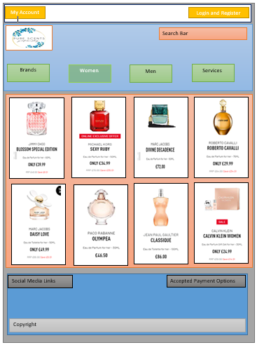
Design

Slide 15
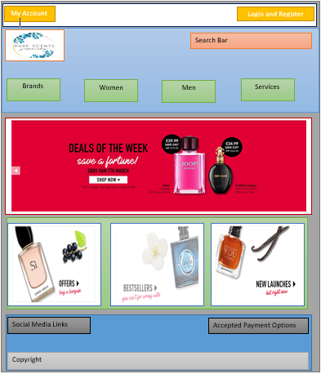
Design

Slide 16
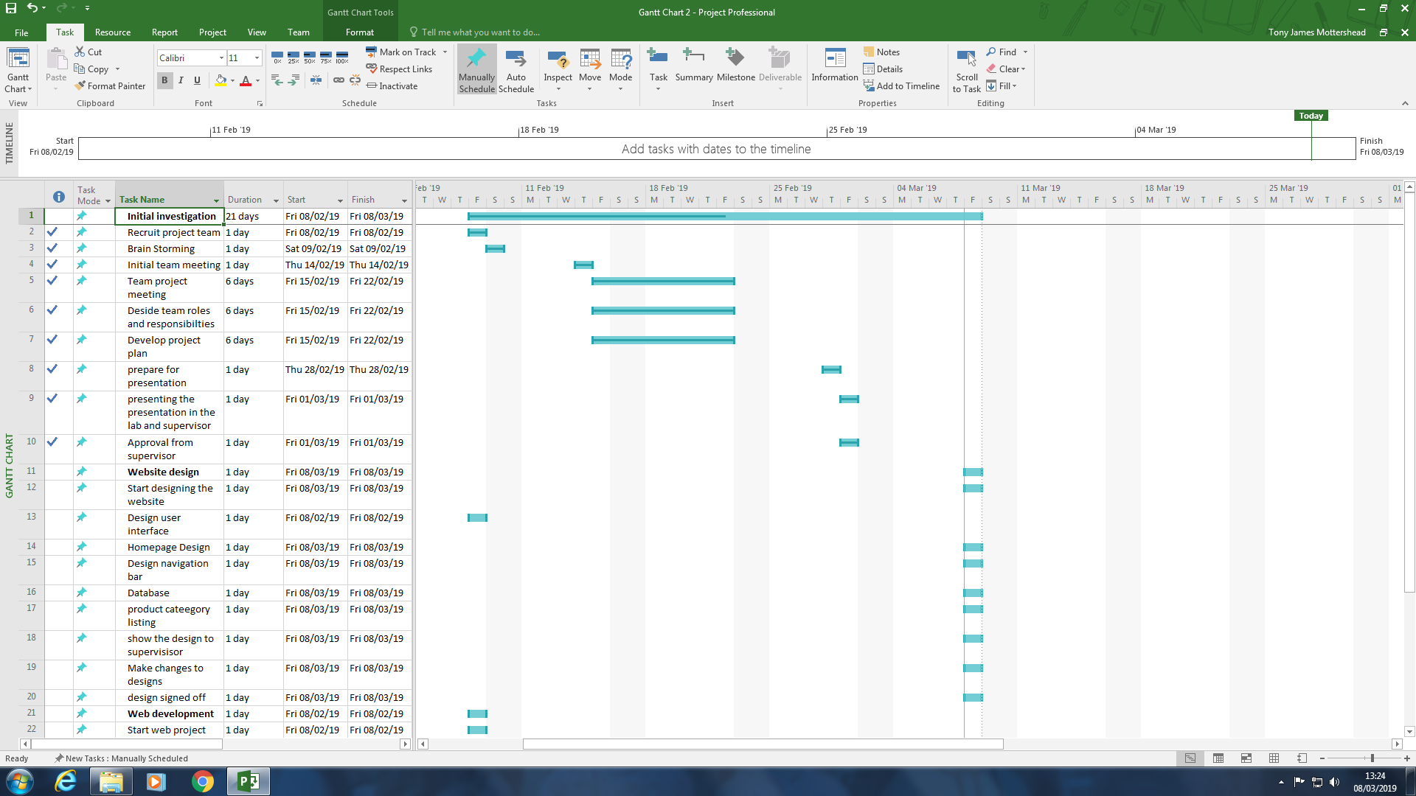
Gannt Chart

Slide 17
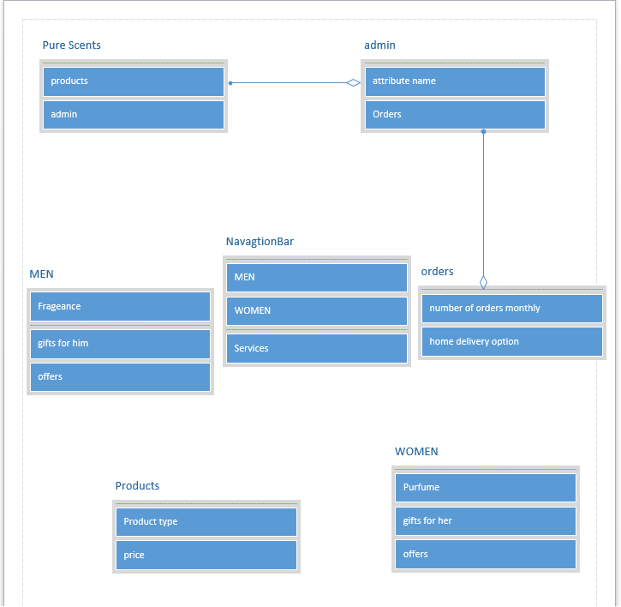
ER Diagram

Slide 18
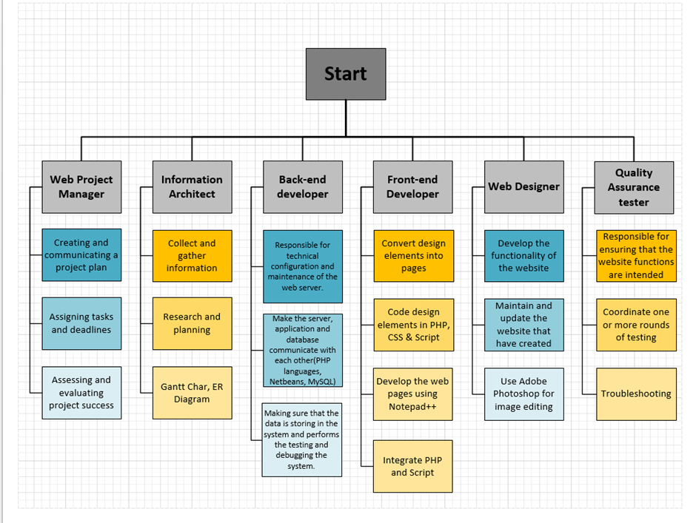
WBS

Slide 19
Thank you for listening

